Slide 1
Gradiometers for Planetary Science
Mark Lindeman 2-20-2026

Slide 2
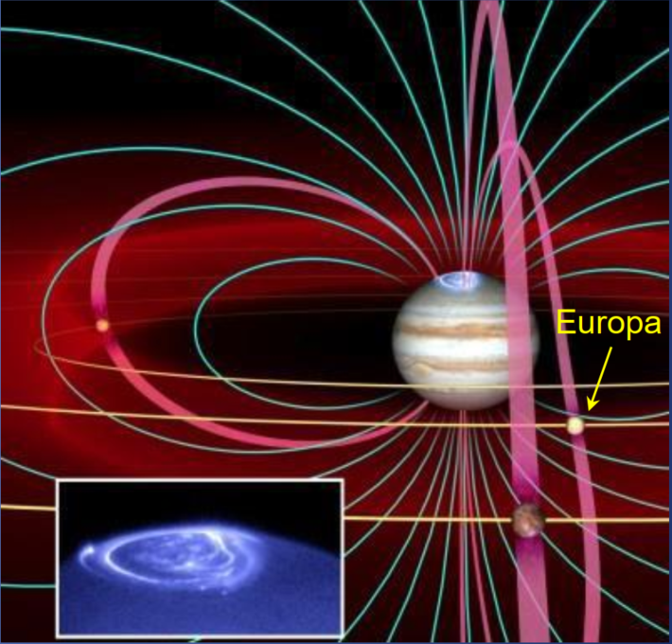
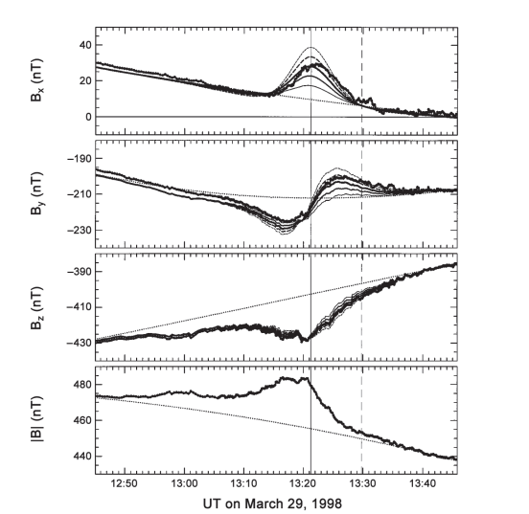
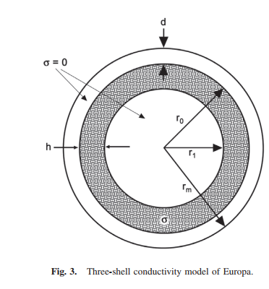
Jupiter Is a Huge Rotating Magnet
Jupiter's Magnetic field is 100s of nanotesla (nT) at Europa’s orbit
May induce electrical currents in conducting materials
The Galileo Spacecraft observed a magnetic response from Europa
Margaret Kivelson Group at UCLA identified a magnetic dipole signal from Europa
Attributed to salty oceans under several km ice
Jupiter Magnetic Field
Europa’s
Magnetic Response
Ocean Model

Slide 3
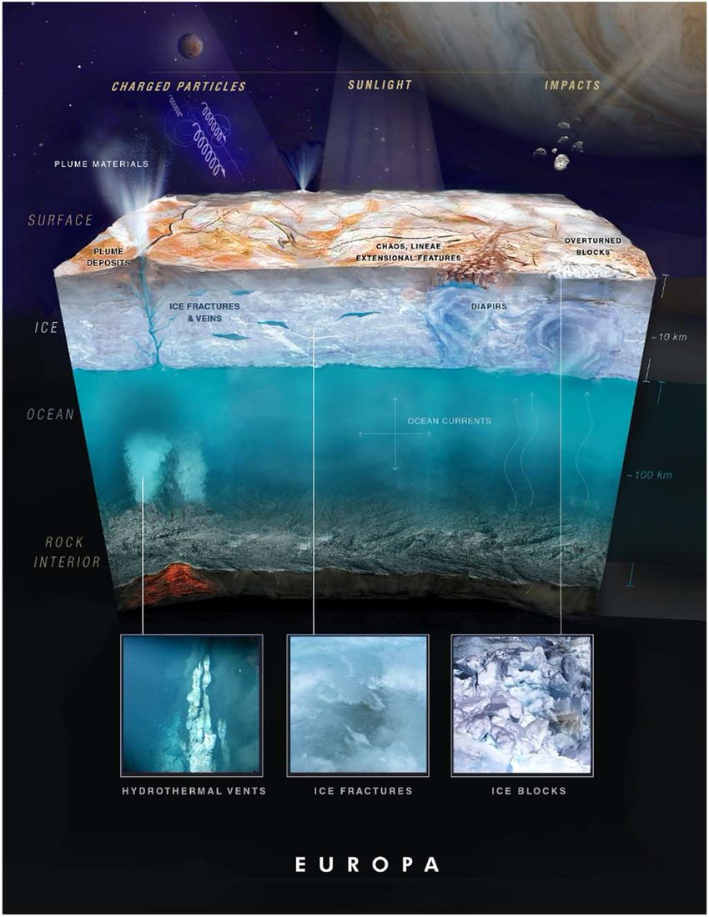
Look for magnetic signals on water worlds
Look for magnetic signals due to
Water in lakes and veins in the ice
Variations in ocean depth
Geysers
Ocean floor vents
Magnetic signals to due water flowing (magnetohydrodynamics)
Subsurface electrical currents
Small features require a more sensitive magnetometer

Slide 4
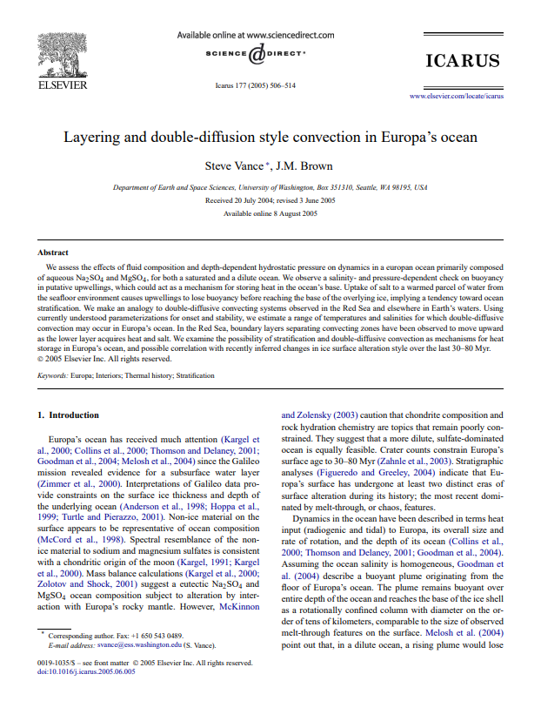
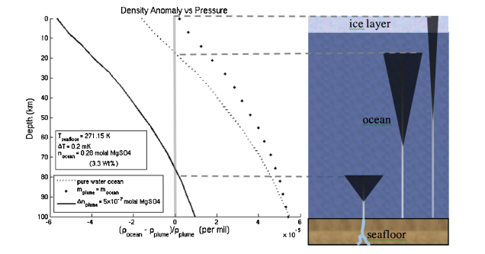
Convection and Geology
Predicted underwater plumes of highly saline water
Predicted convection, layering, Diffusion dynamics in Europan ocean
primarily composed of aqueous Na2SO4 and MgSO4, for both a saturated and a dilute concentrations
Expect greatly varying conductivity in plumes, layers, and currents
Should result in fine scale magnetics signals
What if we could map these magnetic signals?

Slide 5
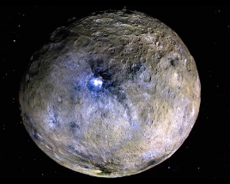
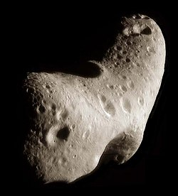
New Asteroid Science:
Ceres is a possible water world
Geological features suggest brine under the ice
Solar wind may induce a weak magnetic response from the subsurface brine
Previously undetectable asteroids
Fluxgates were not able to detect magnetism of low magnetism asteroids
These include on Eros, Lutetia, 67P, Braille, Steins, etc.
Map the weak magnetic fields of these objects
Provide evidence about composition and evolution
Solar wind induced signals from metallic parts
Eros

Slide 6
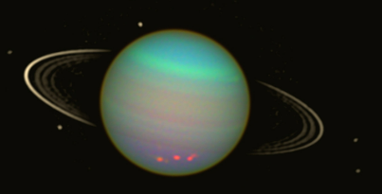
Uranus system
The Uranus is system is called out in the Decadal system
Moons are likely water worlds:
Ariel
Umbriel
Titania
Oberon
Also the Magnetosphere of Uranus offers interesting plasma physics to study between visits to moons using a sensitive highfrequency range magnetometer (MHz)
What if we had magnetometer with sensitivy far exceeding fluxgates over bandpass between 0 Hz – 10s of MHz instead of 0-20 Hz?
Uranus and Moons

Slide 7
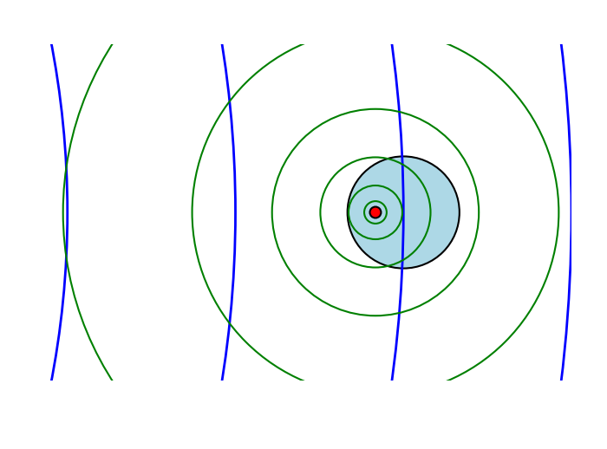
Idea: low gradient fields induce high gradient response
Jupiter applies a varying magnetic field to Europa
This induces electrical current in conductive regions (of ocean)
Spatial variation in conductivity results in local variations in the magnetic field gradient
These local features can have a steeper gradient then the nonlocal large-scale fields from distant sources
Provides a sensitive probe of local variations in conductivity or magnetism under the surface
Gradiometer measures the first derivative of the magnetic which is large near sources, but falls off as r⁻⁴
Conductive Region
External field from Jupiter or Solar Wind
(blue)
Induced field gradient from conductive regions
(green)
The induced magnetic field has a larger gradient than the solar wind field

Slide 8
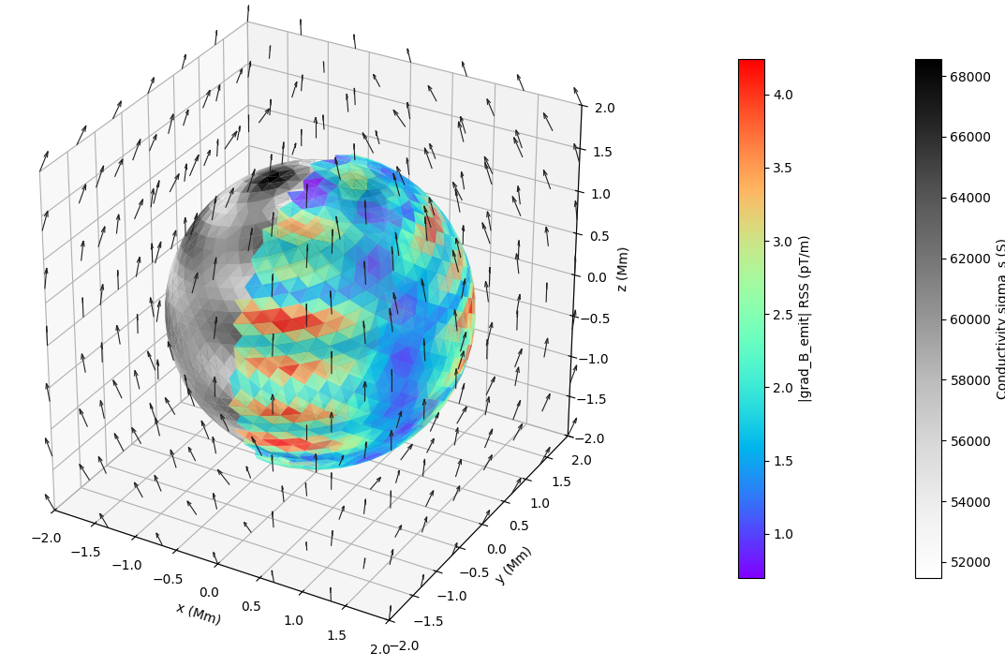
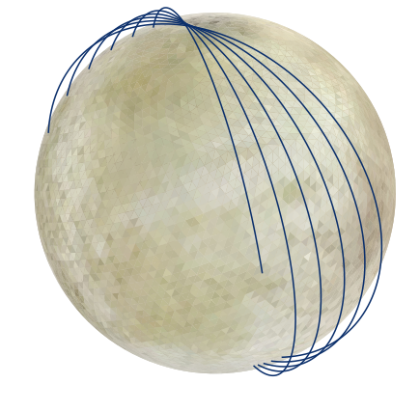
Measure Magnetic Gradients from Orbit
Induced Magnetic Gradient Features
(rainbow)
Conductivity Features of Ocean (grey)
Measure Magnetic Gradients to Observe Magnetic Features
Orbit 100 km above surface
Magnetic field Vectors

Slide 9
Why Use Magnetic Gradiometer?
Induced Magnetic Gradient at 100 km (rainbow)
Picks out nearby sources like magnetic areas in planetary objects
Detects electrically conductive regions through their magnetic response to ambient fields
Even though the magnetic field is very smooth, the gradient is not smooth
Information about the magnetic structure of the body
Filters out large scale noise sources like the solar wind
Conductivity of Ocean (grey)
Magnetic field Vectors

Slide 10
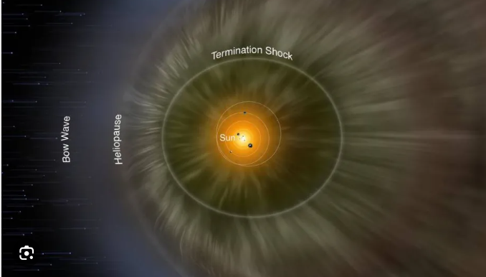
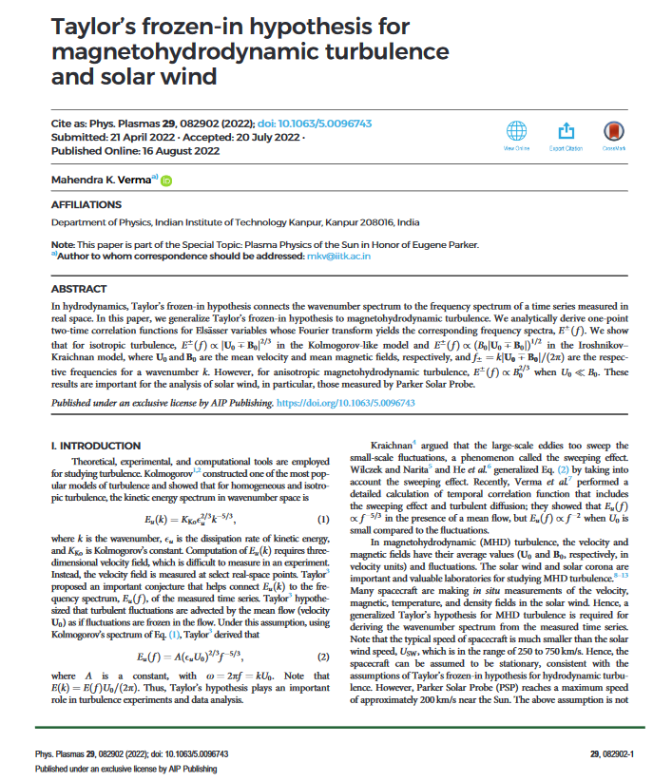
Solar Wind Magnetic Noise
Issue: Solar Wind May Overwhelm Signals
Solar Wind is a source of magnetic noise varying up to 100 nT level near earth
nT magnetic fluctuations dominate signals we want to detect
Want to detect pT or smaller signals from small scall planetary features
About the solar wind:
Though the magnetic field varies a lot over time, it is fairly uniform on meter to kilometer scales
Solution: use a gradiometer configuration to effectively null out solar wind
Local magnet sources have a significant gradient on this scale

Slide 11
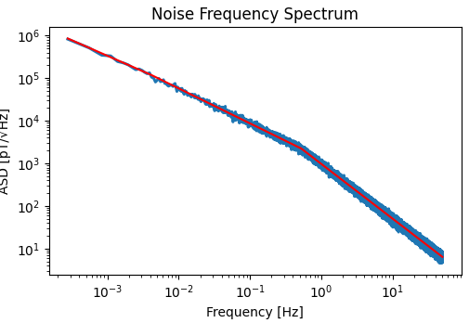
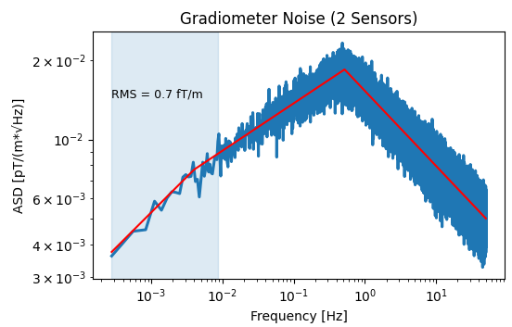
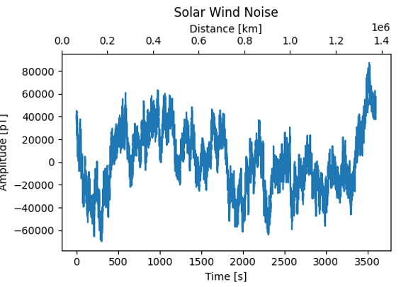
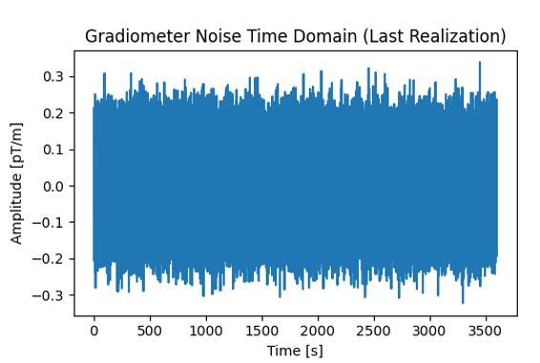
Filtering by Gradiometer
Raw Solar Wind Noise
Filtered Solar Wind Noise
Gradiometer removes long wavelength, low frequency magnetic signals from solar wind
Removes long term correlations in the solar wind noise
Preserves signals from nearby magnetic sources
These have much steeper gradients
Modeling predicts noise filtered to ~ 1 ft/m
Easily sufficient to measure planetary magnetic gradients
Suppress

Slide 12
Modeling of Gradients

Slide 13
Magnetic Field Model
Induced Magnetic Gradient Features
(rainbow)
Model magnetic field gradients to verify implementation is practical
Conductivity is modeled as a thin shell
Ambient oscillating magnetic field from Jupiter
Faraday’s law: magnetitic fields normal to the surface induce toroidal currents on the sphere
Toroidal = no divergence, has curl
Current produces emitted fields
Self consistently solve for currents and emitted fields to satisfy Faraday’s Law
Automatically includes magnetic field inductance
Conductivity Features of Ocean (grey)
Magnetic field Vectors

Slide 14
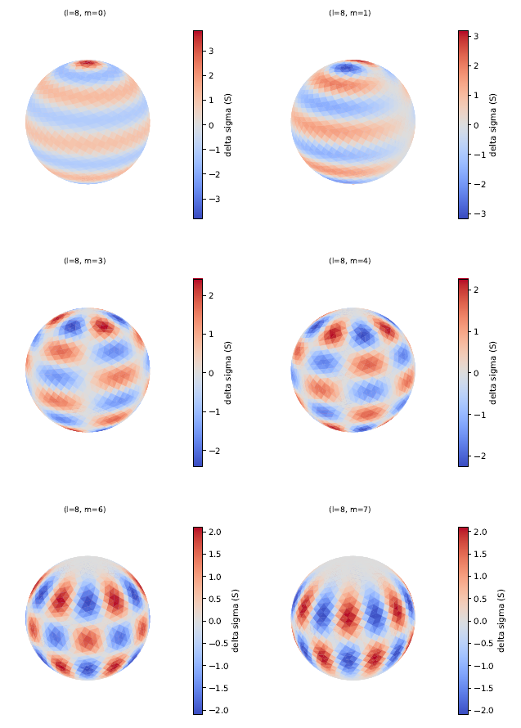
Approach to Modeling
Spatial distributions of Magnetic fields, conductivity, electrical currents are decomposed into spherical harmonics
Avoids issues with boundary conditions, gridding volume
Only need to model surface of sphere
Fourier analysis is uses to compose Time dependence into different frequencies, represented as phasors
Spatial harmonics are encoded as phasors to represent time dependence
Modeled only toroidal currents on surface
Normal fields produce toroidal currents
Assuming poloidal currents are negligible
Poloidal = diverging currents, no curl
Poloidal current implies charging and capacitance on the surface
Perhaps variations in conductivity can cause some divergence, which is neglected
Plan to validate this assumption
Spherical Harmonics

Slide 15
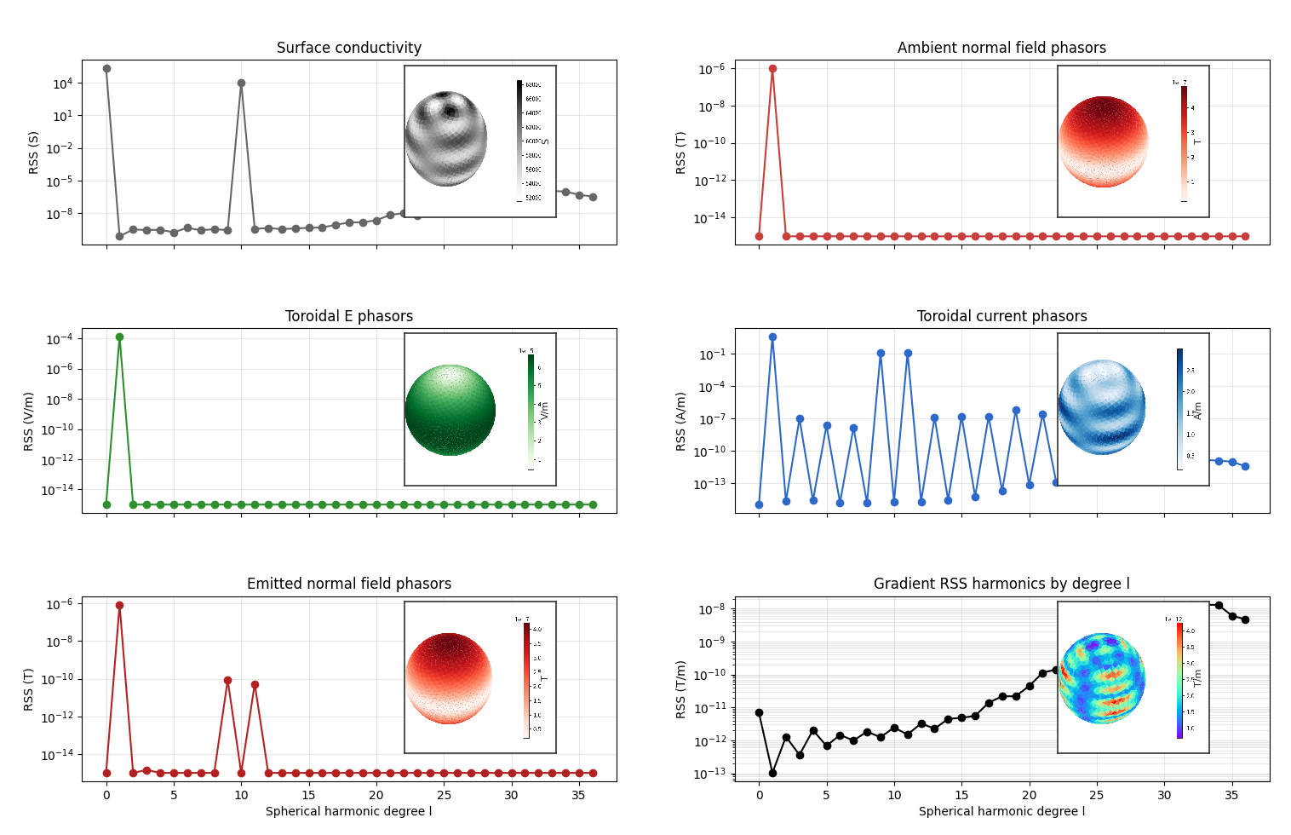
Calculations in Harmonic Space and Visualizations on Sphere
Start with a distribution of conductivity in “ocean”
Represent as a sum of spherical harmonics
Example: (1) Uniform + 5% in higher harmonic
(Y_{10,2}+ Y_{10,-2} )
Apply oscillating magnetic field
Model: Z axis, 10 hours, 1uT
Mag field normal to sphere is used in computations (2)
Compute Electric field on Surface (3)
Find self consistent solution
Induced current harmonics (4)
Emitted mag. field by currents (5)
Calculate gradient of emitted fields (6)
Gradient provide
Information about conductivity of oceans
Modeling of expected signals measurable by gradiometer
(1)
(2)
(3)
(4)
(5)
(6)

Slide 16
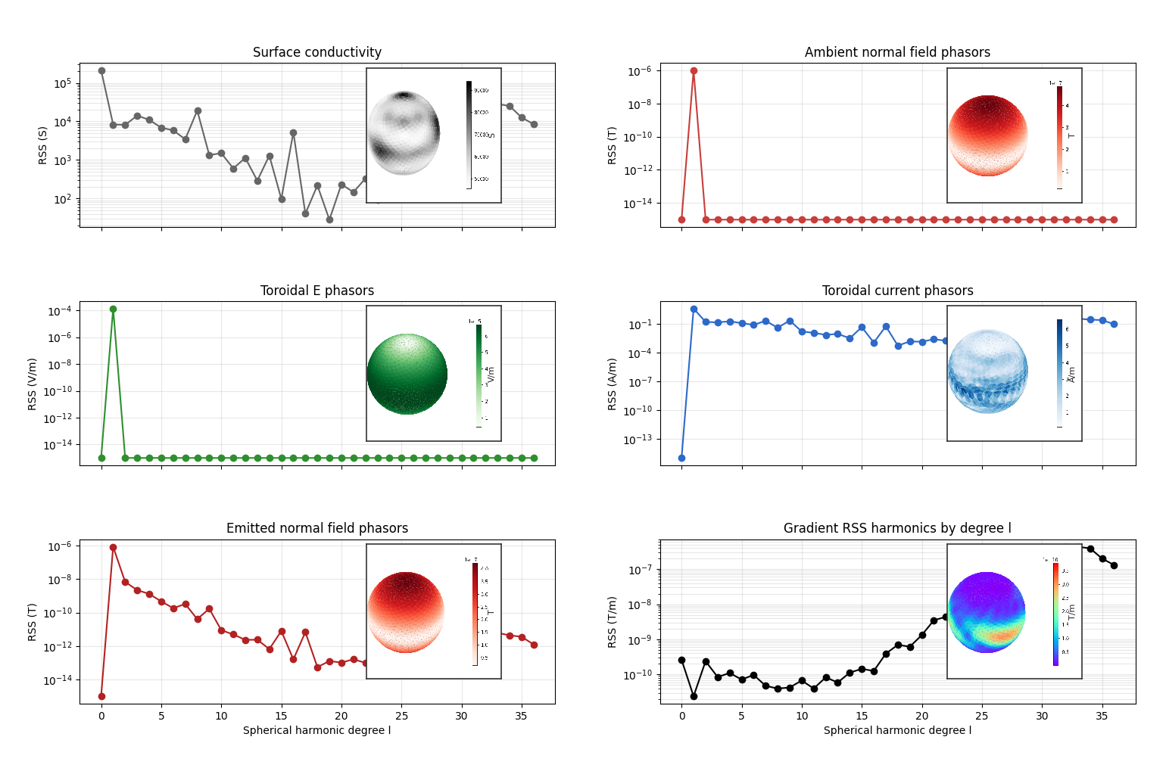
Multiple Conductivity Spatial Harmonics
Any conductivity distribution is modeled as a sum of harmonics
The harmonics combine nonlinearly with the ambient magnetic field harmonics to produce the emitted magnetic field
Features in the conductivity show up in the gradient data
Note that the plots of the gradients only show mean amplitudes
Really, the gradients contain much richer information than plotted:
3x3 tensors
Amplitude and phase information
Frequency dependent
The full gradient tensor can be measured to gleam information about the magnetic sources
(1)
(2)
(3)
(4)
(5)
(6)

Slide 17

Magnetometer Requirements
Induced Magnetic Gradient Features several pT/m
(rainbow)
5% variations in conductivity could produce gradients ~ few pT
Want to resolve gradients of ~ 1 pT/m to measure 5% variations
Bandwidth:
0 to 9 mHz used to resolve 160 km surface regions shown every 140 seconds
1 m size gradiometer requirements:
Fits on a single space craft
1/f noise requirement: 300 fT / root Hz at 1 Hz
Well within capabilities of HTS SQUID magnetometers (22 fT/ root Hz @ 1 Hz)
1 km size gradiometer
Two or more spacecraft
1/f noise requirement 400 pT/ root Hz
Well within the capabilities of fluxgate magnetometers (100 pT / root Hz @ 1 Hz)
Gradiometer sensitivity scales linearly with size, so long as it is smaller than the feature size you would like to detect
Features much smaller than the altitude of the space craft will be hard to detect due to 1/r^4 scaling of magnetic gradients
5% variations in conductivity (RMS)

Slide 18
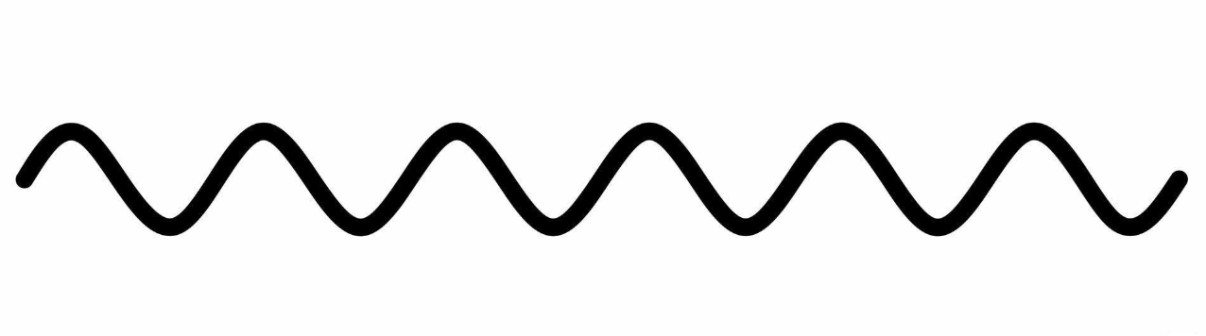
SQUID Technology
Superconducting Quantum Interference Device
Electric current quantum tunnels through the two insulating junctions
Tunneling depends on quantum interference of (+) and (-) waves
How the waves interfere depends on the magnetic flux in the loop area
Flux shifts the phase of (-) wave compared to (+) wave
Modulates the tunnel current
Extremely well calibrated: because depends on area of loop and flux quantum (h/2e)
sensitive and very fast
Our proposed implementation: High Temperature Superconductor (HTS) SQUID system
Demonstrated 77K sensitivity: 1000 X more sensitive than ECM Fluxgates
30 fT / Hz^{1/2} noise
Much larger frequency range compared other technologies (0 – 10s of MHz) such as search coils
Wave of superconducting electrons
Wave (+)
(+)
Magnetic Flux into loop
Josephson Junctions: thin layers of insulator which block current
Current
(-)
Wave (-)
Phase shifts depend on magnetic flux

Slide 19
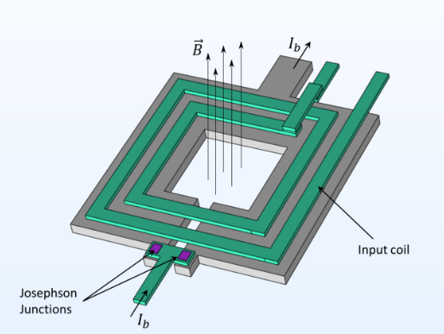
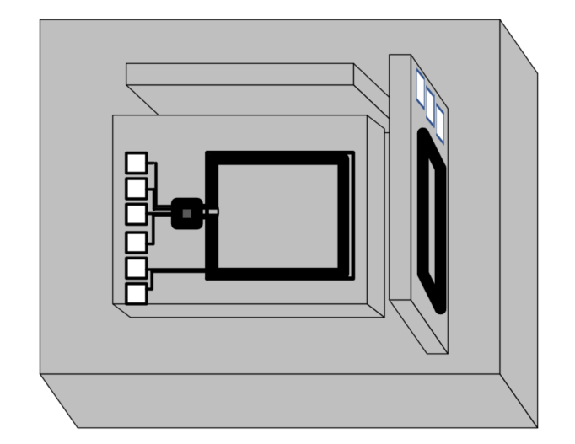
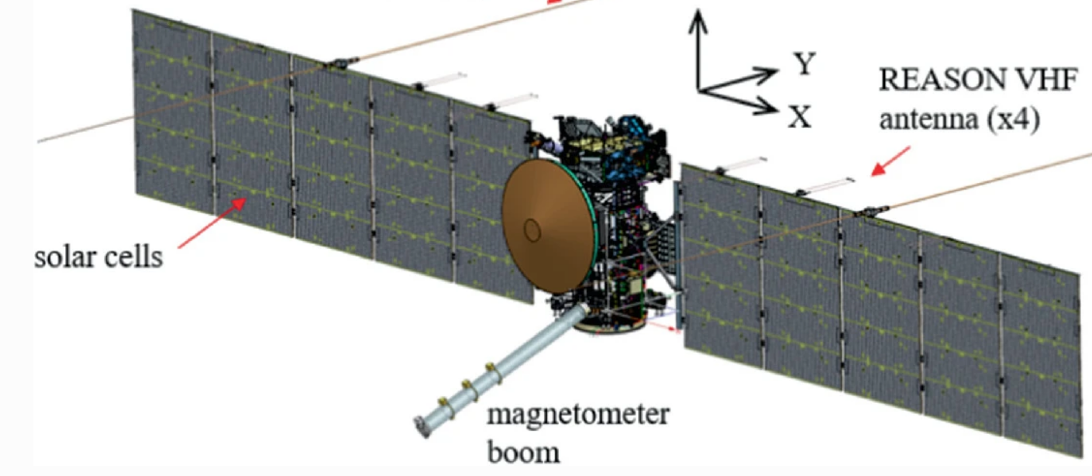
Implementation on a spacecraft
Couple SQUIDs with appropriate input coils are smaller than ~1mm
Wrap on in a 4 cm scale XYZ package to measure magnetic field vector in three dimensions
Mount multiple of these XYZ on a spacecraft boom
Electronic readout
Low noise HTS SQUID
(<1 mm)
Package of 3 for X, Y, Z components, with input coils , shielding etc. (~4 cm x 4cm x 4 cm)

Slide 20
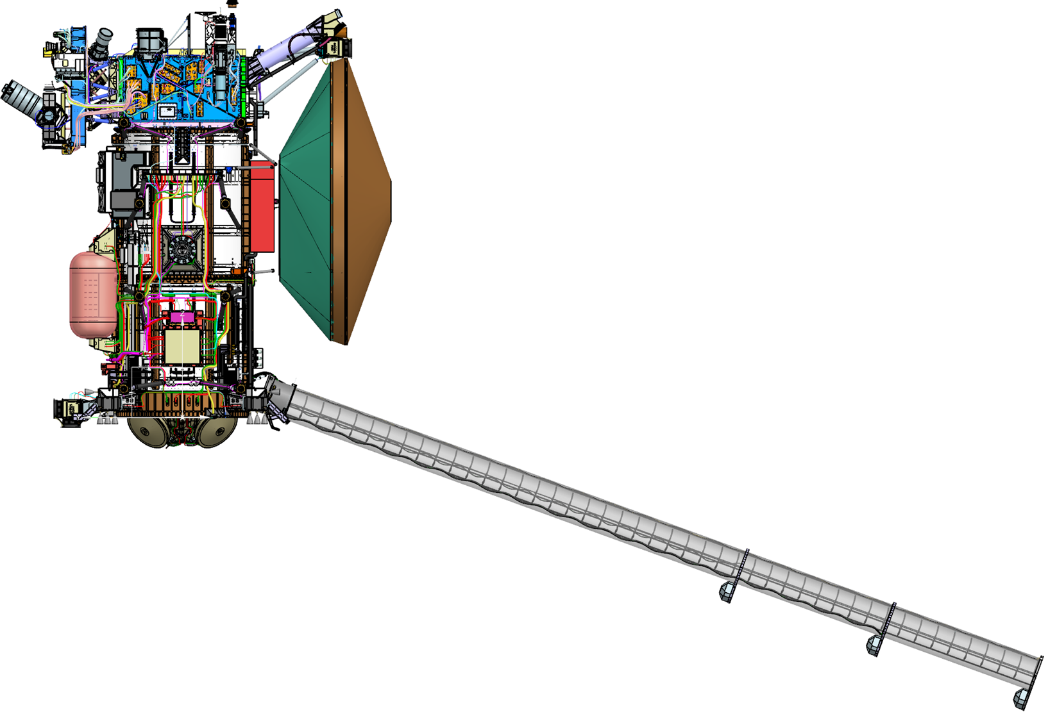
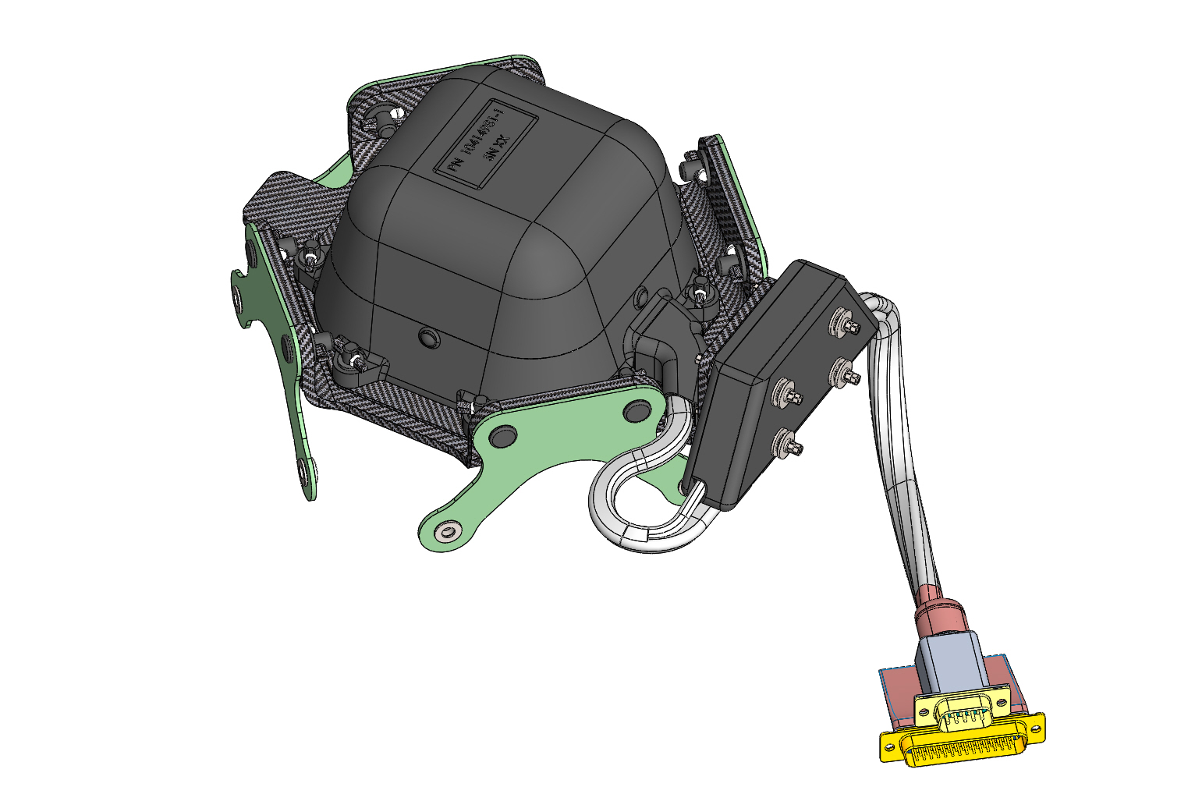
Fluxgate Technology
Fluxgate magnetometers such as The Europa Clipper Magnetometer work by applying an alternating magnetic field to a magnetic material
The ambient magnetic field adds to the applied field to determine how the magnetization saturates during each cycle.
The magnetization is measured by a readout circuit to find the ambient field
Placing these magnetometers on different spacecraft with km of separation would provide a sensitive measurement of the magnetic gradient (pT/m level)
About 1000 X less sensitive than SQUIDs, but workable with a long baseline
Polarized
(magnetic
domains)
8 kHz
Cycle
ECM sensors
Onset of saturation is a measure of the ambient field
Reversed polarization

Slide 21
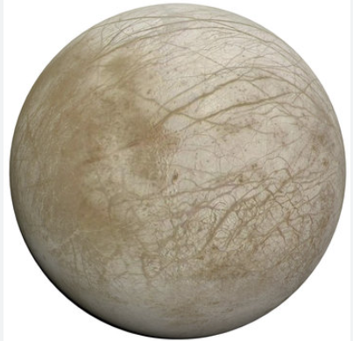
Gradiometer Implementations
A magnetic gradiometer
Measures the change in magnetic field across a length of the gradiometer
Filters out the large-scale features to detect the local small-scale features.
With signal processing, can also filter out spacecraft generated noise.
Option 1: Single Spacecraft
Gradiometer is ~20-meter boom
Requires a sensor with sub pT level noise
Relatively Insensitive to solar wind noise
We present this option
Option two: Twin Spacecraft km apart
Gradiometer distance is between the spacecraft
Allows for a less sensitive magnetometer
Requires coordination between spacecraft
More susceptible to solar wind noise
Not yet investigated
10 m
2 km

Slide 22
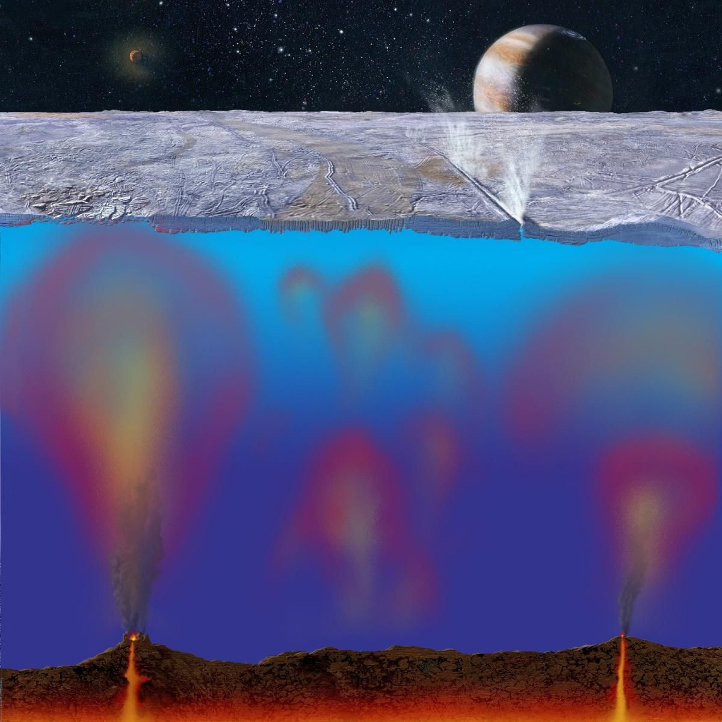
Conclusions
Magnetic Gradiometry may open a new window into oceans worlds hidden under the ice.
We described an implementation using high HTS SQUIDs.
Requires gradiometer and spacecraft design to reduce unwanted noise.
Numerical modeling confirms detection of realistic signals from ocean features is feasible.
Targets for the gradiometer technology include
Subsurface ocean mapping, subsurface lakes, ocean convection, hydrothermal vents, saline gradients,
weakly magnetic asteroids
In addition, SQUID technology has other applications which require increased sensor performance:
Broadband planetary plasma magnetics measurements
Heliopause measurements

Slide 23
Back Up Slides

Slide 24
Orbital Properties
Sample the magnetic field from orbit
100 km altitude
Orbital period = 2.086 hours
speed = 1389.215 m/s
Initial Modeling used 160 km ground pixels (not shown)
node drift per orbit = 1.605 nodes
114 s crossing time
Orbit 100 km above surface

Slide 25
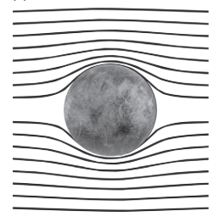
Europa’s Response to Jupiter Field as Seen by Galileo
The Galileo Spacecraft observed a magnetic response from Europa
Margaret Kivelson Group at UCLA identified a dipole signal from Europa
Attributed to salty oceans under several km ice
Conductive ocean response to oscillating field from Jupiter
Potentially habitable world
We would like to know more about the subsurface ocean
Measure magnetic response
Khurana et al.: Electromagnetic Induction from Europa’s Interior
Inferred conductive ocean under the ice of Europa

Slide 26
Conductors Respond to Magnetic Fields
Application of a changing magnetic field on a conductor induces an electrical current in that conductor
The electrical current induces a magnet field that opposes the changed in the magnetic field
The amount of field induces depends on
The area of the conductor
Its electrical conductivity
The rate at which the magnetic field is changing
Measurements of the response can be used to infer the presence of an electrically conductive material, as in a metal detector.
Even works if the conductor is a planetary sized object like a salty ocean
Applied Field Changes
Electric current
Magnetic Response

Slide 27
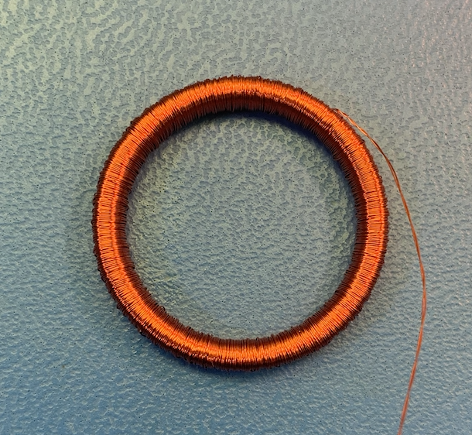
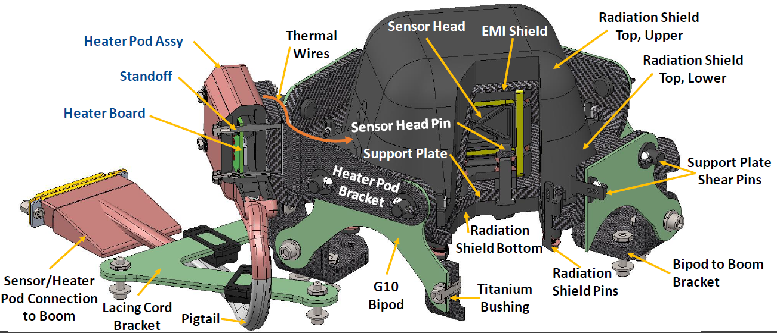
About the ECM Fluxgates
Key Parts
Rings of soft magnetic alloy which magnetize in an external field
Drive and sense coils that detect the magnetization
Employed lots of plastics and adhesives with carbon added for moderate conductivity to provide shielding and protect against IESD
Use of metal was minimized
Temperature: regulated to -110 C at Jupiter
Two magnetic rings, with sense 3 coils to detect magnetization in X, Y, Z directions

Slide 28
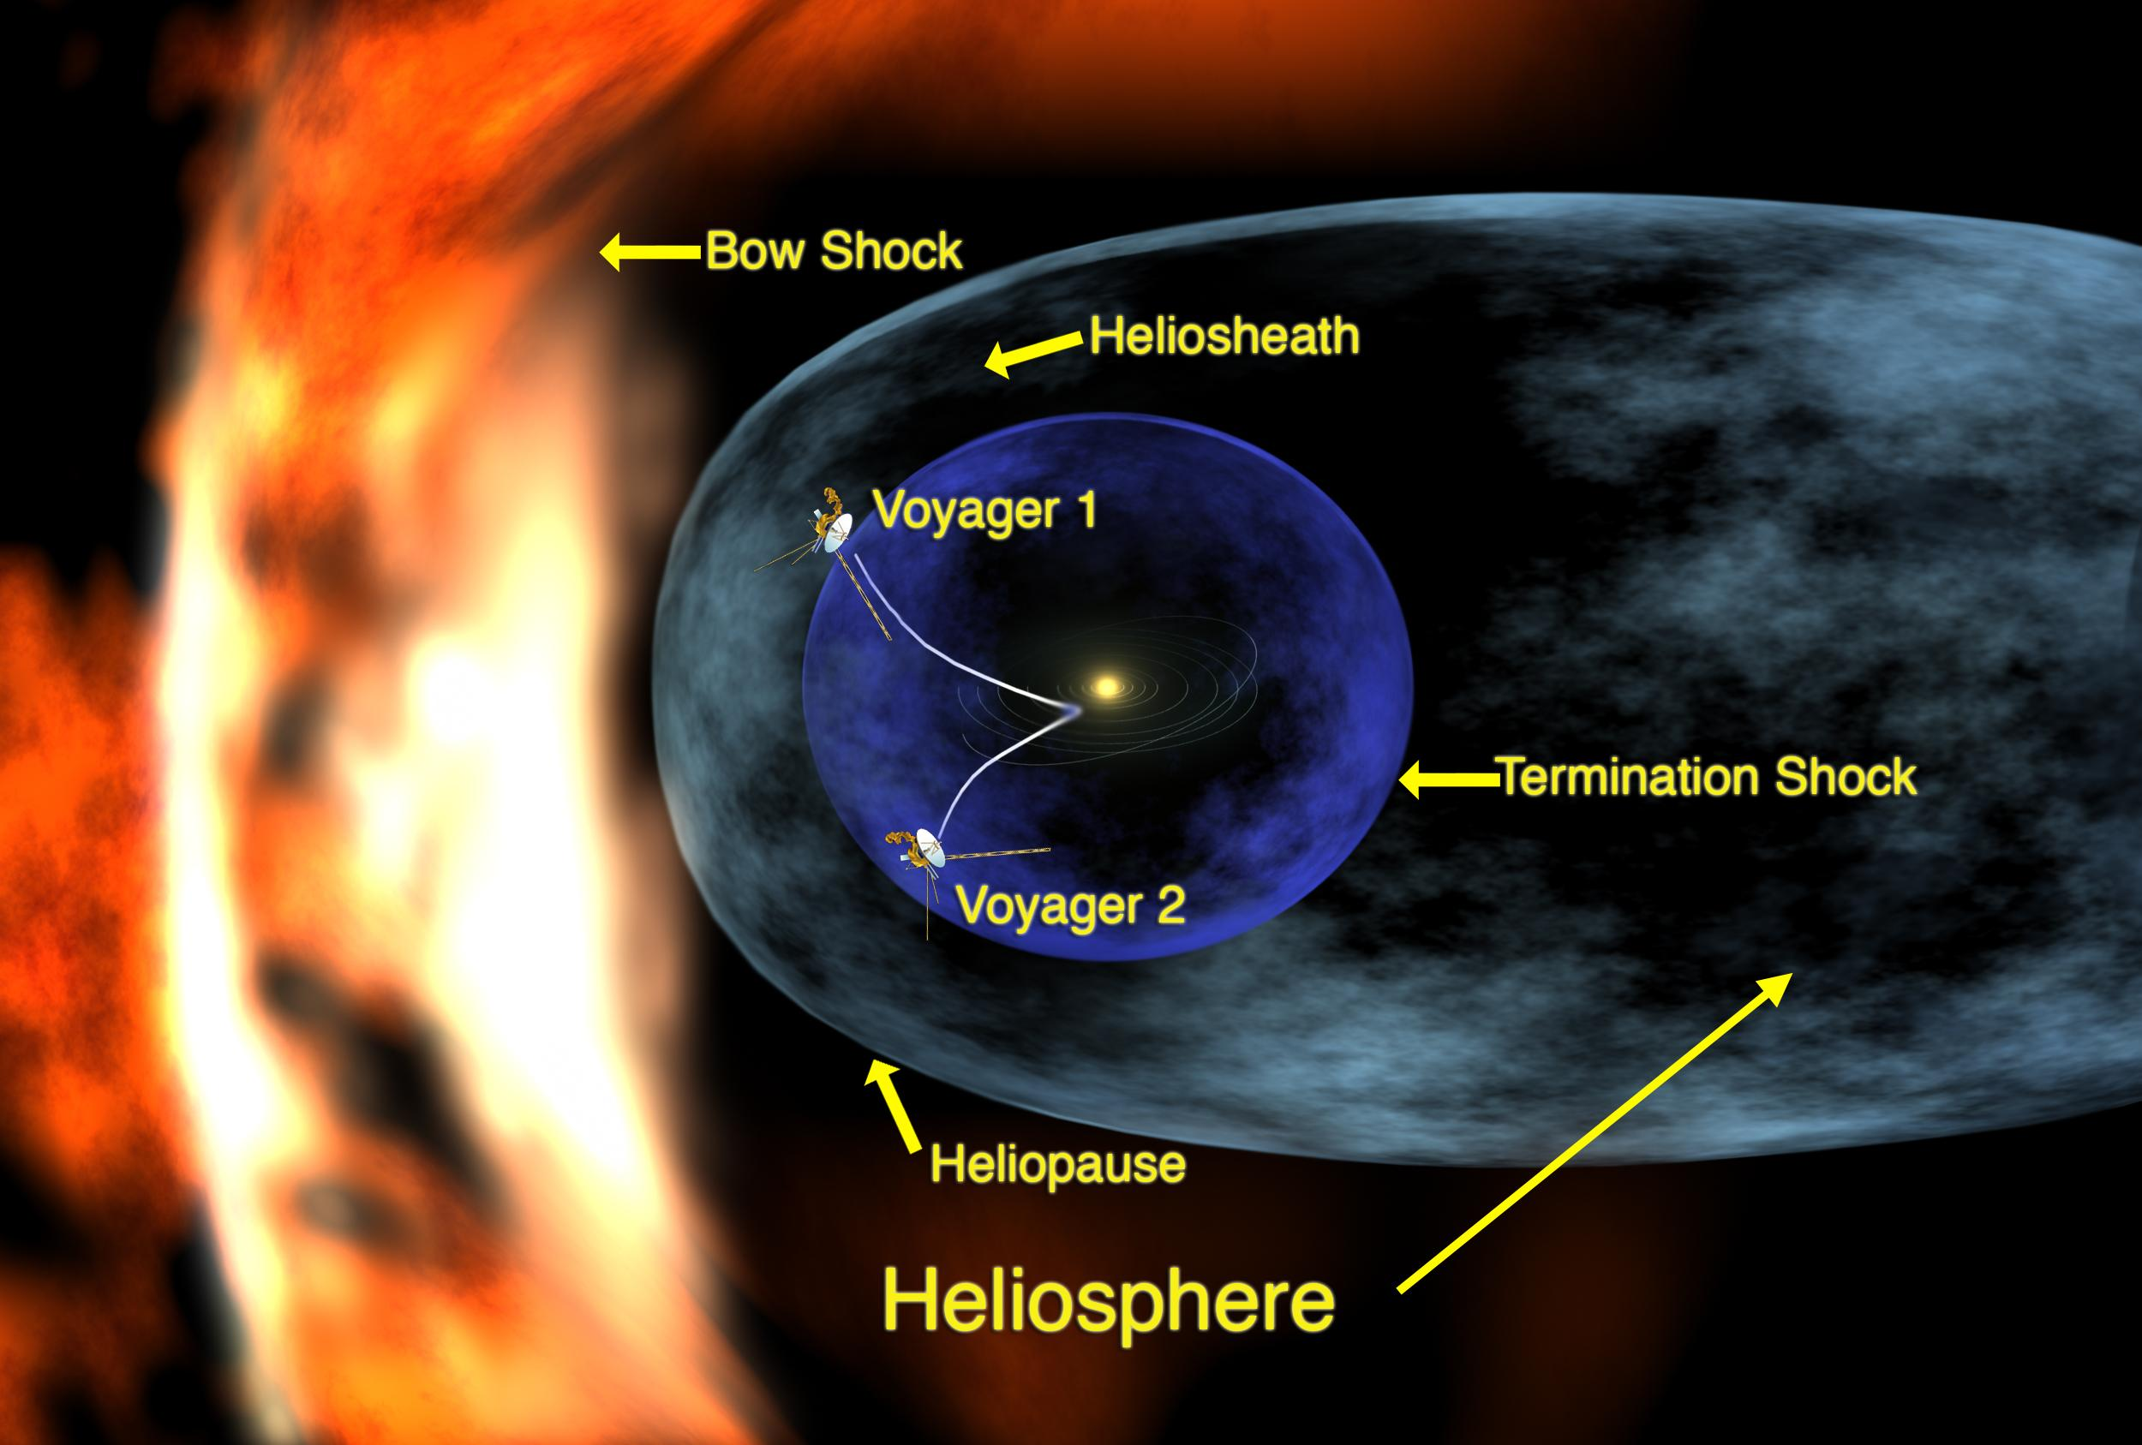
Heliopause measurement
Magnetic Measurements out at the heliopause require more sensitivity because magnetic fields are very small
However, would take decades to get there

Slide 29
Europa Clipper Magnetometer Measurements
The planned measurements will provide information about the
Ocean depth
Salinity
Magnetic response is measured from flybys of the Europa Clipper
Fit a model of the ocean’s magnetic response to the magnetic field data to find these parameters
What is possible with more sensitive magnetometry?
Ocean Model

Slide 30
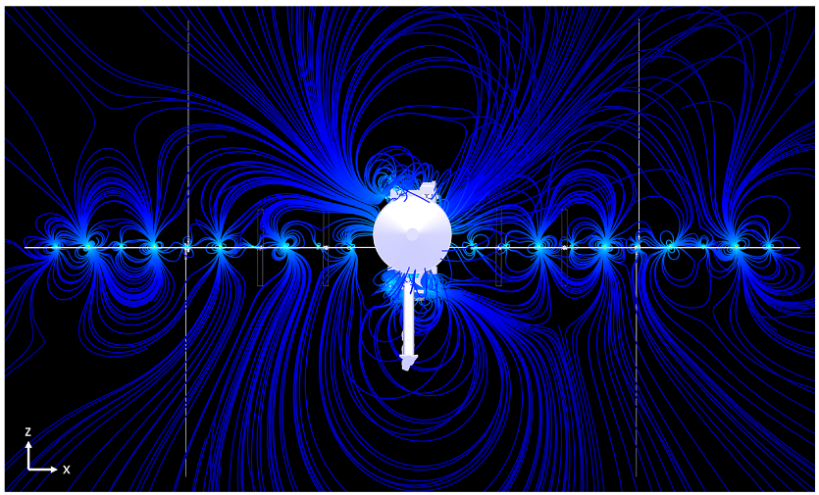
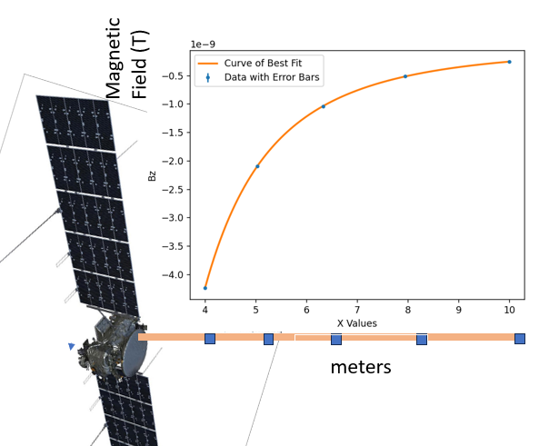
Issue 2: Spacecraft noise
Issue: Spacecraft noise can dominate over magnetic field
Solution: 1 fitting data from several sensors can separate out this noise from the ambient field
Numerical simulation shows that fitting magnetic field of several sensors can effectively separate spacecraft fields from ambient field
Fit to simple multipole expansion to find B
f= B+c/r³ + d/r⁴ + e/r⁵
Removes random sources of noise near center of spacecraft to find unknown external field B to sub pT levels
Spacecraft Design
Short Coax cables should have very low emissions
Block low frequencies with capacitors and use ac electronics
Concentrate digital circuity in small shielded boxes
Power with stable ac or DC circuits whose frequency content is not greatly affected by varying loads
Ideally signaling is via fiber optic
Chopping: Also, could rotate spacecraft to separate signal from noise
EC Spacecraft Magnetic noise (C. Cochrane)
Fit curve to simulated field measurements in from numerical model .
Random noise sources near S/C center

Slide 31
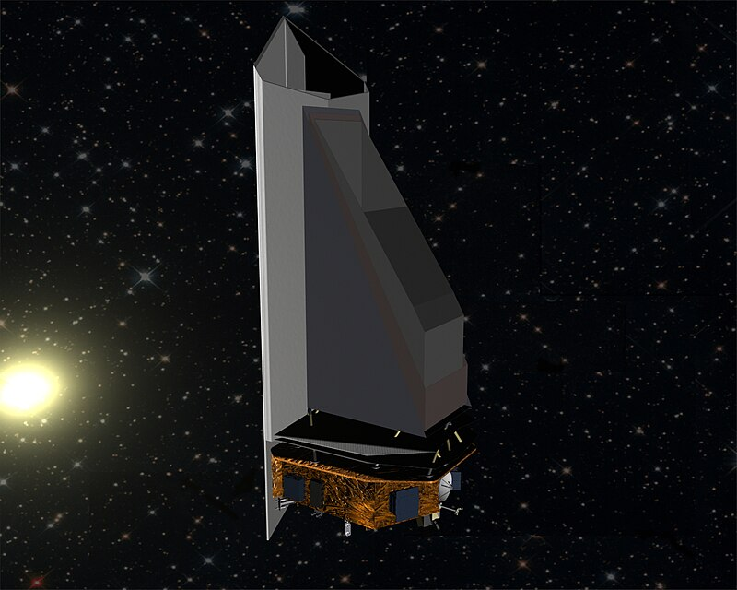
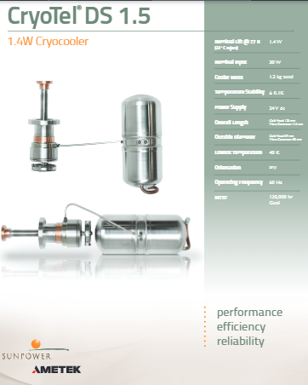
Issue 3: Low Temperature Operation
SQUIDs Gradiometer must operate at 80 K or below
Solutions:
Passive cooling possible
NEO surveyor will passively cool IR detector arrays to 40 K at Earth Lagrange point (L1)
Cooling tiny SQUIDs, which use nW of power, is much easier
Objects at Saturn and Uranus are typically below 80 K
Closer to the sun, cryocoolers are also an option
Small cryo coolers are available that weight 1.2 kg and use 30 W
NEO Surveyor

Slide 32
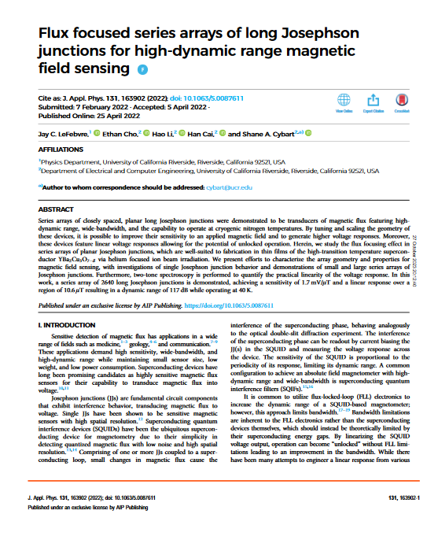
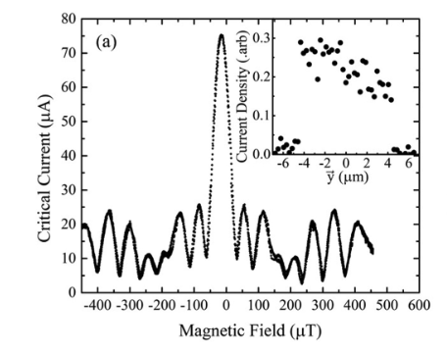
Issue 4. Tolerance to Noisy Environments
Issue: Can Quantum interference devices handle a noisy magnetic environment?
A variant of YBCO Squids called Josephson Junction arrays work in high field environments
UC Riverside reports “developing superconducting magnetometers designed … with enough dynamic range to operate unshielded with background magnetic fields, such as that of the Earth”
Replace SQUID loop with a tiny junction only device
Effective size of junctions is small enough that that flux doesn’t saturate (microns)
Earth field

Slide 33
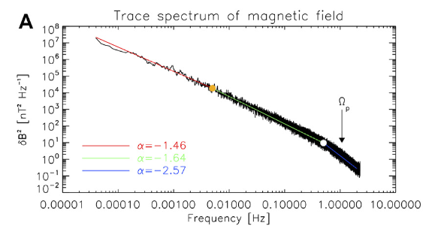
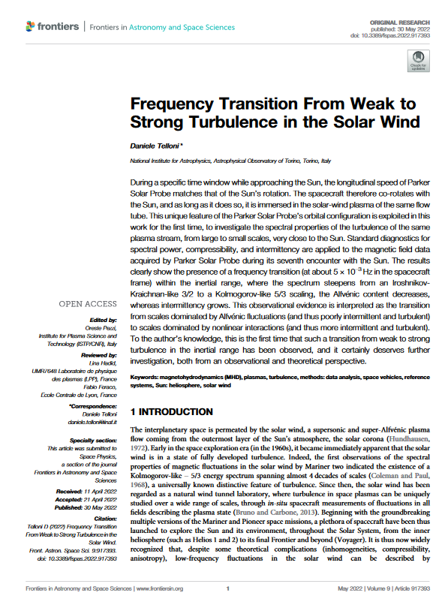
Solar Wind model
My simulations of gradiometer performance incorporate a solar wind model
Taylor frozen flow model:
Solar wind drags magnetic field lines with it.
Field is not changing in a comoving frame
Power spectrum of solar wind magnetic field noise is well known
. (Source: Daniele Telloni, “Frequency Transition From Weak to Strong Turbulence in the Solar Wind”) (Near Earth)
Given the power spectrum and velocity of the solar wind , the simulations calculate the spatial variations in the magnetic field
Shows that gradiometer effectively filters our solar wind magnetics
Solar Wind Power Spectrum

Slide 34
Asteroids– Ceres model

Slide 35
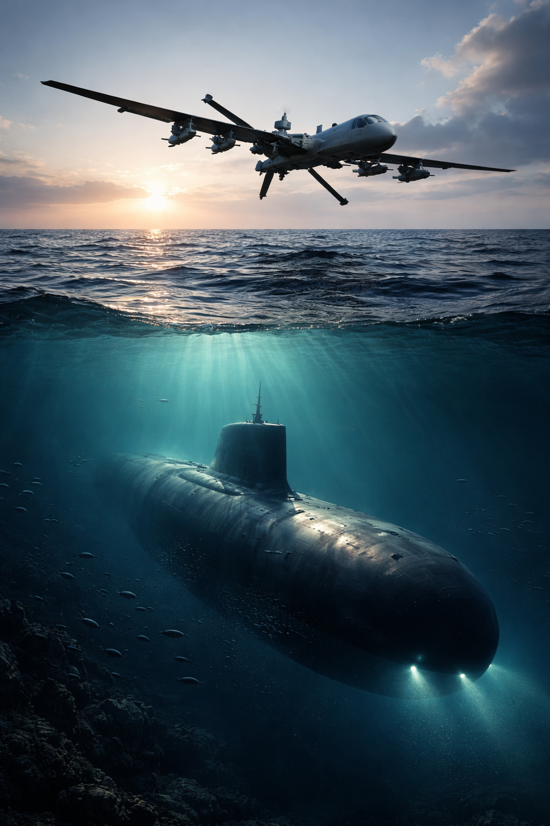
Detecting Subs
Assume a steel sub 500 m , with magnetism reduce by 100X through heroic effort
Assume 10 m/s boat or aircraft near surface of ocean
Magnetic Field from sub is at surface only 5 ppm of Earths Dipole field at surface
Sample every 300 m / 30 seconds for 30 mHz sampling bandwidth
First order gradiometer:
Gradient from sub is ~12% of Earth Dipole field
Sub is detectable from surface of Earth or low flying drone
1 m first order gradiometer
Magnetometer 1/f noise requirement ~ 7 pT/Hz^{1/2} @ 1 Hz
Well within capabilities of HTS SQUID magnetometers (22 fT/ root Hz @ 1 Hz)
Not sure if devices that can tolerate Earths field have this sensitivity.
Second order gradiometer to help separate from earth field
Gradient from is 2600 X Earth field gradient
2 m second order gradiometer
Magnetometer noise requirement: 1/f noise ~ pT/Hz^{1/2} @ 1 Hz
Well within capabilities of HTS SQUID magnetometers
Not sure if devices that can tolerate Earths field have this sensitivity.
Need to get 1/f noise of UCR devices that can handle ambient fields

Slide 36
Meteor Search
1 meter long Second order gradiometer should be able to detect 1 kg meteor at 20 m below thee surface
Meteor second derivative should be 10000 X Earth dipole field
Magnetometer 1/f requirement 60 fT/ Hz
Well within capabilities of HTS SQUID magnetometers
Not sure if devices that can tolerate Earths field have this sensitivity.

Slide 37
Buried Meteors

Slide 38
Junk?

Slide 39
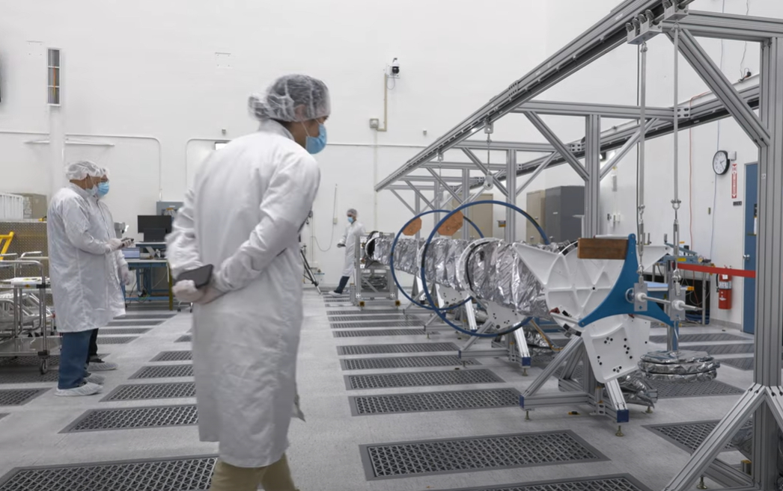
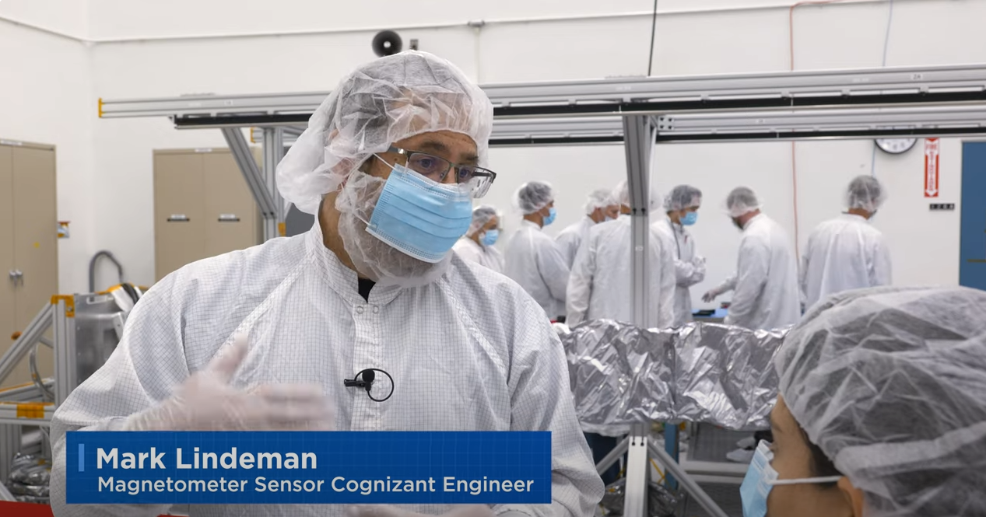
Follow Up Mission: Europa Clipper
Europa Clipper Magnetometer (ECM) on boom
The planned measurements will provide information about the
Ocean depth
Salinity
What could we do with much more sensitive magnetometers?
Three fluxgate magnetometers located on a boom to isolate from spacecraft magnetics
1
ECM sensors
Notes:
Possible hand over to Karen
Harness builds 3 sets. One set delivered to ECM. One set split to vault (int/ext), prop mod, and boom.
ECM test and cal on spare.
E2E electrical on actual flight cable.

Slide 40
Science Beyond Fluxgate Technology
What could be detected with a much more sensitive technology?

Slide 41
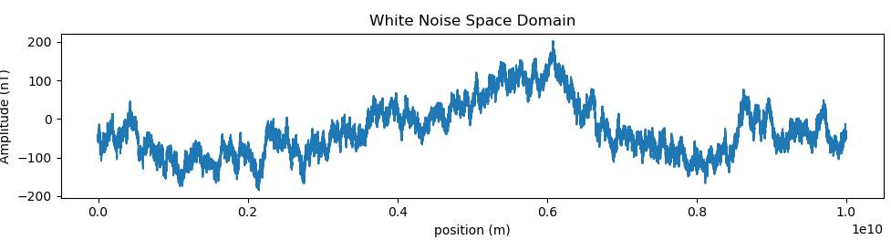
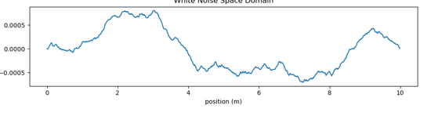
Numerical Model of Solar Wind Magnetic Noise
Noise varies greatly on large scales:
A gradiometer measures differences in field across its length (A-B)
Gradiometer filters out large scale variations, but detects small scale ones
Should be able to detect gradients of size 100 fT/ meter or larger
Back of the envelope calculations: conductive features of Europa to generate gradients detectible at 50 km altitude
~100 nT
Hardly varies at all on the scale of a 10 m long gradiometer
A
~500 fT
B

Slide 42
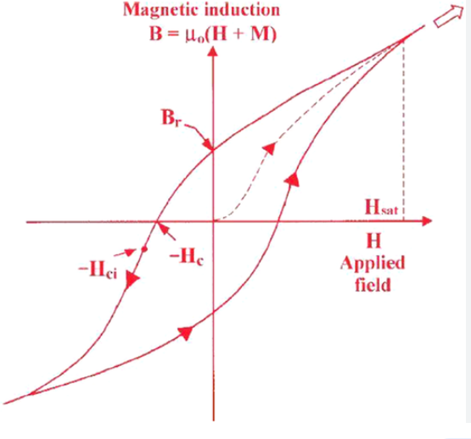
Fluxgates: Operating Principle and Noise
Strong Magnetic field
Fluxgates contain a soft magnetic material
Magnetic domains align with external magnetic field
Hysteresis: Domains do not perfectly align; they lag behind the external field
Small hysteresis at large fields because all domains are aligned, larger at zero field
ECM fluxgate apply associating field at 8 kHz.
Hysterics loop causes a magnetic response at 16 kHz (and other multiples)
The 16 kHz signal depend on the strength and direction of the external field
The signal has some noise because domains flips have some randomness (~30 pT / Hz^{-1/2})
(magnetic
domains)
Magnetization Curve
8 kHz
Cycle
No external field
Intrinsic noise due to magnetic domain realignment
Reversed Strong
Magnetic field

